Slide 1
Towards natural conversation with machines
Milica Gašić
Dialogue Systems Group
Notes:
Deep learning has made a revolution in machine learning, natural language processing and computer vision. In reinforcement learning it has been mainly applied in problems that can be simulated and gamified such as Atari or the game of Go. Today I’m going to discuss the necessary steps needed for Deep Learning and Deep Reinforcement Learning to achieve state of the art results in dialouge modelling.

Slide 2
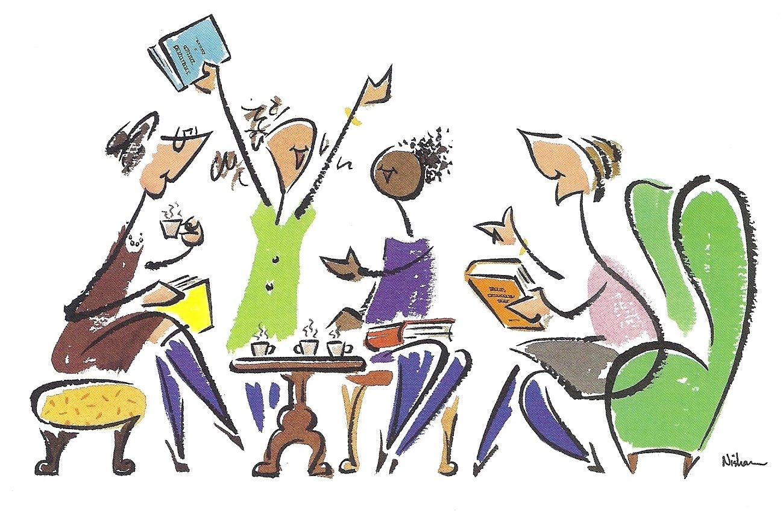


Research question
Virtual assistants are very popular: 1 billion calls every day
Expected revenue USD 16 billion in 2021 (Tractica)
Current models are unnatural, narrow in domain and frustrating for users.
How do we build a continuously evolving dialogue model capable of natural conversation?

Slide 3

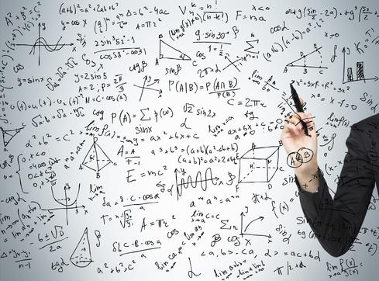

Machine learning for dialogue modeling
Notes:
Modern dialogue systems are built using machine learning

Slide 4
Bottlenecks of the current technology
Immediate:
Models that keep track of context do not scale
Models that learn how to respond learn are very limited
Short term:
Operates only on pre-defined databases
Supports short-term conversation
User models are unrealistic
Simplistic models of feedback/evaluation
Long term:
How do we model rich conversations?
How do we teach a machine to talk about piece of text?
How do we support large (potentially infinite!) action sets?

Slide 5
Statistical dialogue modelling

Slide 6
Statistical dialogue modelling

Slide 7
Example 1 – No belief tracking
Notes:
THAI is similar to HI

Slide 8
Example 2 – Belief tracking
Notes:
New probability is much higher
The new action is much better than the one taken before

Slide 9
Problem: Scaling up belief tracking
Problem:
If we treat every concept separately we need training data for every concept. Does not scale!!
Solution:
Reuse knowledge for different concepts
Essential ingredients
Semantically-constrained word vector embeddings
Architecture that shares parameters

Slide 10
Semantically-constrained word-vector embeddings
Notes:
Concepts: domain, slots, values
We can represent these as distributed vector representations
We can induce semantic information via counter-fitting

Slide 11
Multi-domain belief tracking with knowledge sharing
Notes:
What do we have in the ontology?
What does the user refer to?
What does the system refer to?
How do we keep track of context?

Slide 12
Data sets
Datasets are collected in a Wizard of Oz setting
 | WOZ 2.0 | MultiWOZ
# of dialogues | 1200 | 9855
# of domains | 1 | 5
Avg. # of turns | 7.45 | 14.30
# of slots | 7 | 27
# of values | 99 | 663
Google Faculty Award

Slide 13
Results
Accuracy
 | NBT | NBT-KS | NBT | NBT-KS
Food | 88.9 | 96.4 | 78.3 | 85.3
Price | 93.7 | 97.6 | 92.6 | 93.6
Area | 94.3 | 98.1 | 78.3 | 86.4
WOZ 2.0
MultiWOZ (restaurants)
 | Uniform | NBT-KS
Average Accuracy | 10.8 | 93.2
MultiWOZ
Ramadan et al, Large-Scale Multi-Domain Belief Tracking with Knowledge Sharing, ACL, 2018

Slide 14
Belief tracking vs policy optimisation

Slide 15
Reinforcement learning
observations o_{t}
Dialogue system
reward r_{t}
belief states b_{t}
action a_{t}
Notes:
- Example of rewards

Slide 16
Reinforcement learning
observations o_{t}
Dialogue system
reward r_{t}
belief states b_{t}
action a_{t}
Long term user satisfaction
Policy
Notes:
Explain that Q is long term user satisfaction

Slide 17
Reinforcement learning
Return
Value function
Q-function

Slide 18
Deep Reinforcement Learning
Value function, Q-function or policy approximated via a neural network
These are approximated as non-linear functions which is preferred in reinforcement learning.
However, optimisation algorithms offer only local optima.

Slide 19
Deep Q-network (DQN) algorithm
Q-function is approximated as a deep neural network, the gradient is
This algorithm provides a biased estimate
States are correlated
Targets are non-stationary

Slide 20
Policy approximation as a neural network
Policy is parameterised
The objective function is the value of the initial state
Policy gradient theorem
Directly used in REINFORCE, but also in actor-critic methods

Slide 21
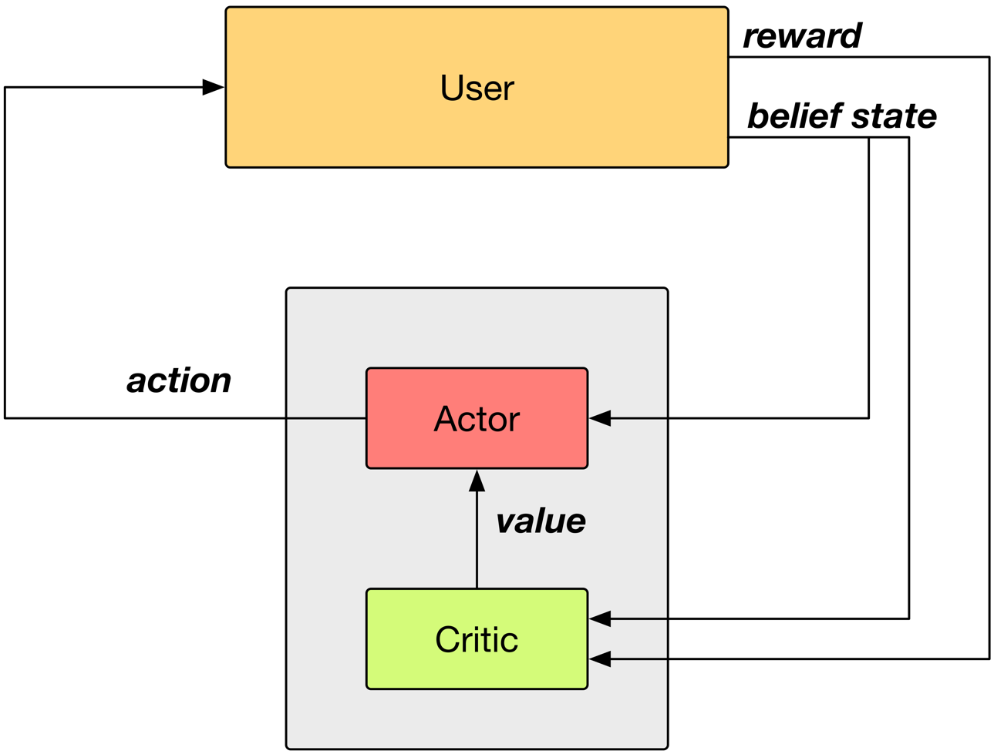
Actor-critic framework

Slide 22
Summary action space
Notes:
When the action space gets, whatever method you use will become computationally expensive. This is typically solved with a summary action space.
Two orders of magnitude actions!

Slide 23
Problem: Too many interactions are needed
Problem: learning is very slow and requires too many interactions. That is why the action spaces are very small, in the order of 10 actions.
Solution: experience reply
Outcome: Ability to learn on two order of magnitude larger action spaces

Slide 24
Properties of ACER
Actor critic algorithm
Uses experience reply
Estimates Q-function off-policy
Uses Retrace algorithm to compute the targets
Uses trust-region policy optimisation

Slide 25
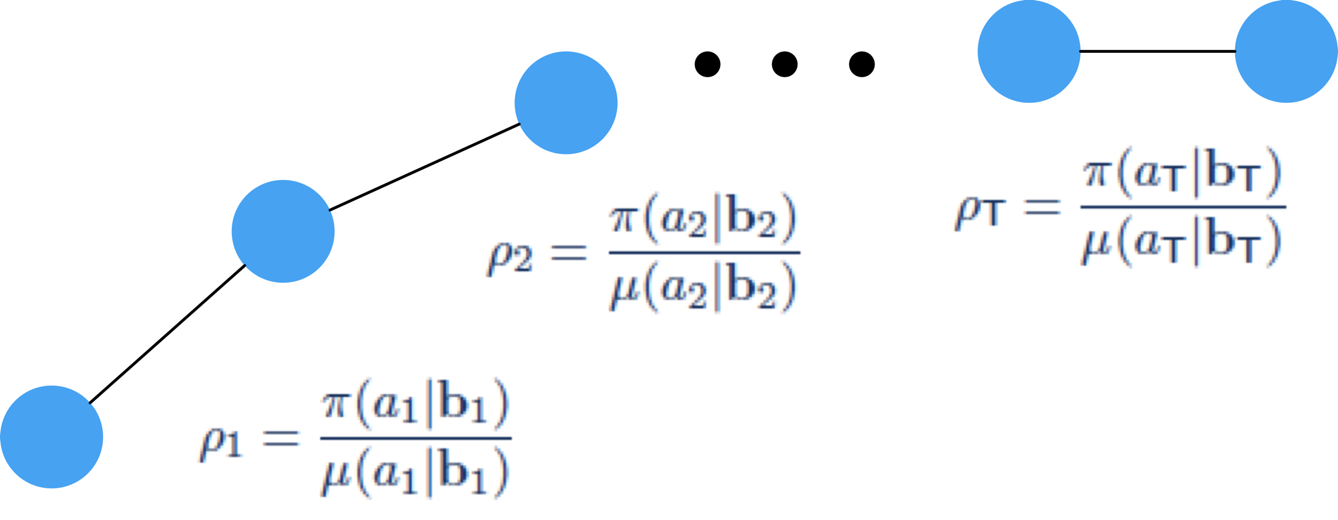
Experience replay
Off-policy learning follows a behaviour policy 𝛍 while optimising target policy 𝛑
This allows for the previous experience to be ‘replayed’
Correct the sampling bias with importance sampling ratio
ER Pool
Sample

Slide 26
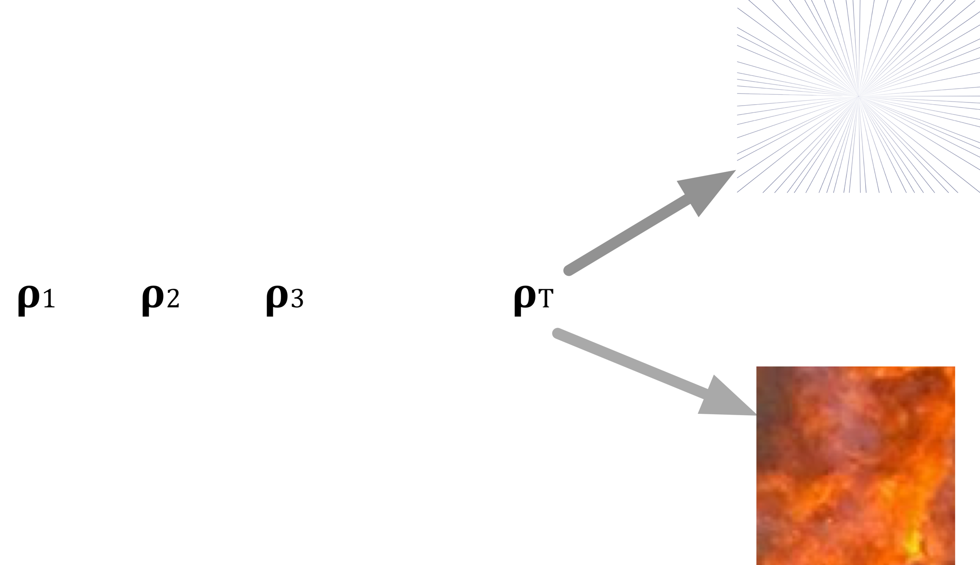
Truncated importance sampling
When we use importance weights for each sample in the trajectory we can easily obtain vanishing or exploding trajectories
This is why we need to truncate the importance sampling weights
We need to add a bias correction term to take into account that we are making an error

Slide 27
Q function targets
Modified loss
Targets are estimated via Retrace algorithm non-biased estimates with small variance

Slide 28
Trust-region policy optimisation (TRPO)
Small changes in the parameter space can lead to erratic changes in the output policy.
Solution: natural gradient, but expensive to compute.
Distance metric in natural gradient can be approximated as the KL divergence.
TRPO approximates KL divergence using first order Taylor expansion and limits the KL divergence between policies of subsequent parameters.

Slide 29
Modified neural network architecture

Slide 30
Evaluation set-up
Pydial open source toolkit for building dialogue systems
Cambridge restaurant domain: 100 venues, 6 slots, 3 requestable
Belief state input of size 268 (last system act, distribution over user intent …)
System summary action space of size 15 (inform, request, confirm, …)
Master action space has 1035
User simulator operating on semantic level

Slide 31
Learning on master action space

Slide 32
Learning on master action space
Human evaluation (~450 dialogues per policy)
ACER | Summary space (15 actions) | Master space (1035 actions)
Success | 89.7% | 89.1%
Reward (20max) | 11.39 | 11.83
Turns | 6.42 | 5.98
Weisz et al, Sample efficient deep reinforcement learning for dialogue systems with large action spaces, IEEE TASLP, 2018
Notes:
Equal if not better. Same success but quicker. But no longer hand-coded.

Slide 33
Conclusions
Machine learning allows us to build dialogue systems that can
share knowledge between concepts
learn among a large number of responses
Challenges ahead
learnable knowledge base
long-term interaction
sentiment-awareness
Long term vision: natural conversation for goal-directed dialogues
Notes:
My research has impact
Long term goal
Hint at how I’ll get there
My next three steps to get there are
Cambridge is the best place to get there because of these reasons
Why is cambridge the best place? If you are head of the dept what you do?

Slide 34


I am looking for PostDocs and PhD students!
I won 3.2M€ of funding by European Research Council and Alexander von Humboldt foundation to do ground research on dialogue
If interested to work with me please email at milicagasic@gmail.com

